Slide 1
String Algorithms
Professor Jorma Tarhio

Slide 2
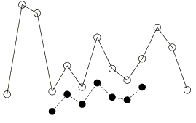
String Algorithms
We develop efficient algorithms for information retrieval and text compression. Most of our algorithms deal with online searching or indexing. Bioinformatics is one of the application areas.
the quick brown fox jumps
brown fox
grown fix
own foxbr
wonb xrof
Exact match
Approximate match
Patterns
Circular match
Jumbled match
Time series
Order-preserving match
Pattern
Contact: Jorma Tarhio

